Slide 1
Graduation Project Conception
Aslene Ouaze

Slide 2
Identification of actors
01
Functional needs
02
Table of contents
Non functional needs
03
Diagrams
04

Slide 3

01
Identification of actors

Slide 4
Main actors
Salesforce Administrator:
A person responsible for managing the Salesforce org, including user accounts, security settings, and data management.

Slide 5
Secondary actors
Community Member:
A person who interacts with the community to share information, ask questions, and participate in discussions.

Slide 6

02
Functional needs

Slide 7
Functional needs
Choice of the community:
Select the community to which we will manage the users
Manage users:
The system must allow users to be managed with the functionalities of activation, deactivation, modification and consultation of the list of users via a data table. Creation of different filters that allow us to facilitate the navigation of the list of users.
Manage connection history:
Create a chart that shows the number of user connections per day, week, years or according to a well-determined date. This allows the administrator to modify the license
Offer a synthetic dashboard,

Slide 8

03
Non-Functional needs

Slide 9
Non-Functional needs
Security:
Access to information is only possible after verification of privileges and access rights, for example : Authentication, Redirections.
Ergonomics and user-friendliness:
The application will provide a user-friendly and easy-to-use interface that does not require any prerequisites, so it can be used by all types of users (even non-computer specialists).
Extensibility and maintainability:
The architecture of the application will allow the evolution and maintenance (addition or deletion or update) at the level of its various modules in a flexible manner.
Performance:
The application must be efficient, i.e. the system must react within a period that does not exceed 5 seconds, whatever the action of the application.
Availability:
The application will be available on 24/24, and 7/7 except during the maintenance period.

Slide 10
04
Diagrams

Slide 11
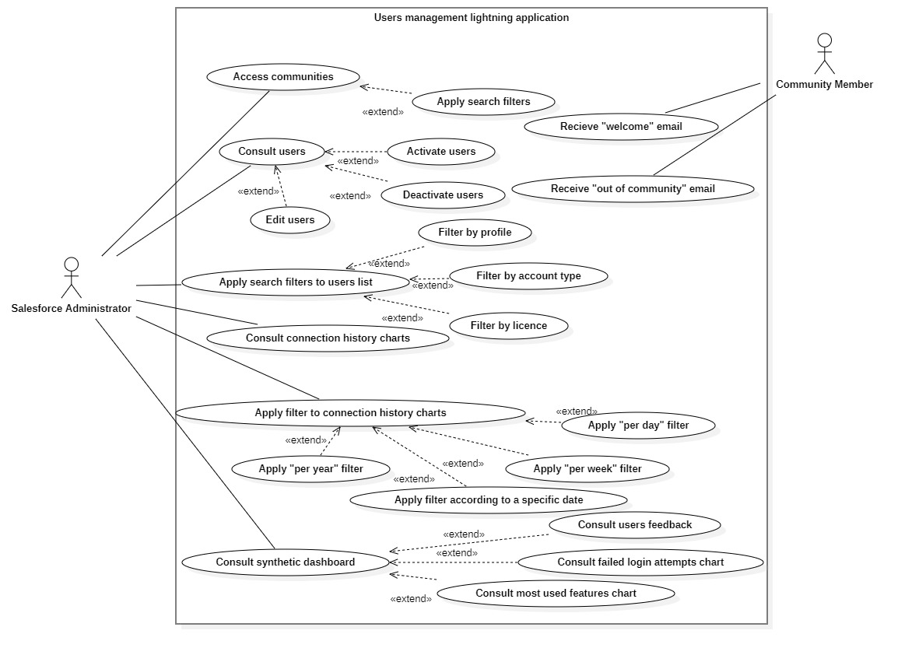

Slide 12
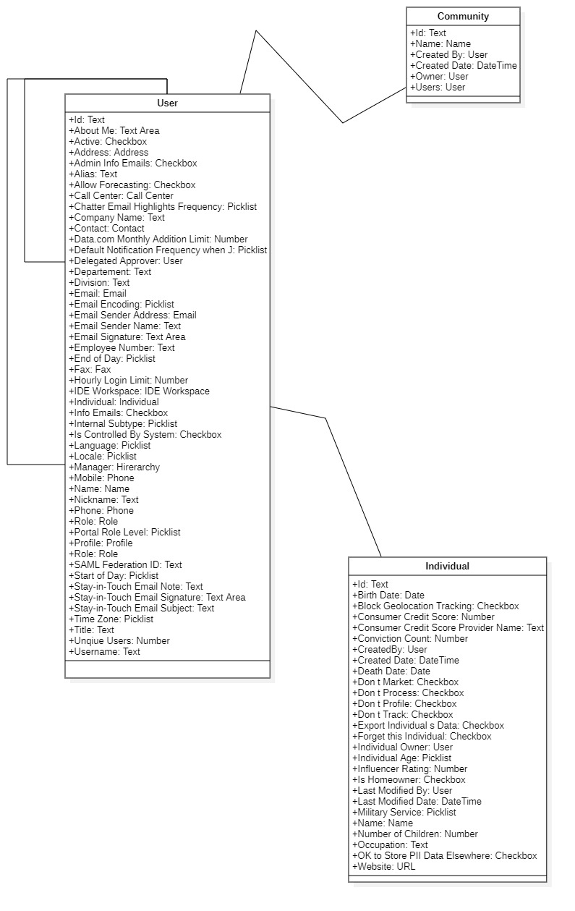

Slide 13
Thanks
Do you have any questions?
Please keep this slide for attribution

